Slide 1
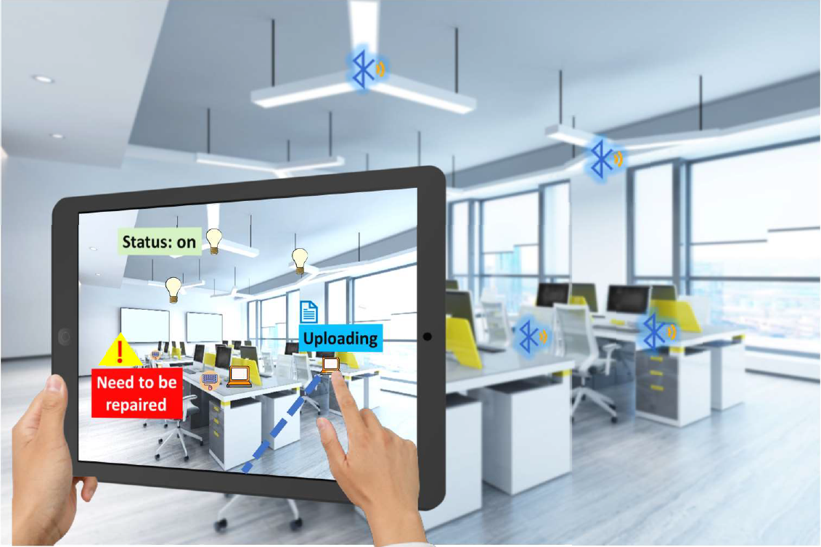
VisBLE
BLE TAG IDENTIFICATION WITH VISION ENHANCEMENT

Slide 2
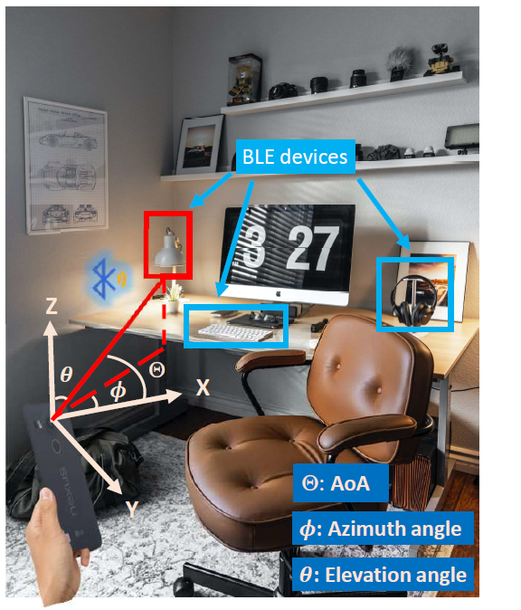
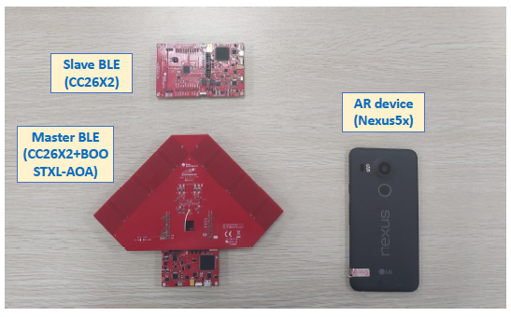
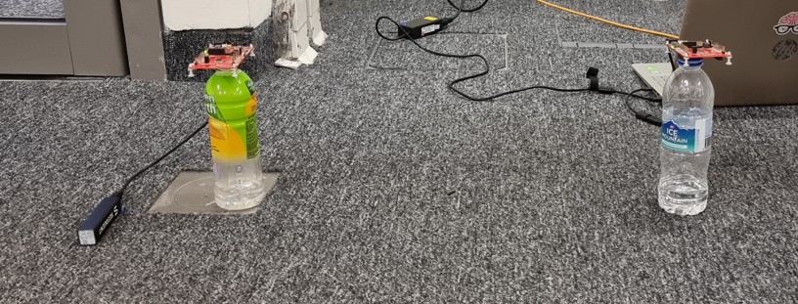
Problem: Locating the BLE Device in a Screen
Idea 1: Rotation based wireless localization mechanism that accurately and robustly locates the BLE transmitter in the camera co-ordinate.
Idea 2: Homography based matching mechanism that identifies target BLE devices with high accuracy in the camera screen.
Research Problem:
Imitate the role of a BLE transmitter with a slave board on top of water bottle.
Based on the AoA data extracted using Ti master board together with homography techniques match the device with suitable bottle.

Slide 3
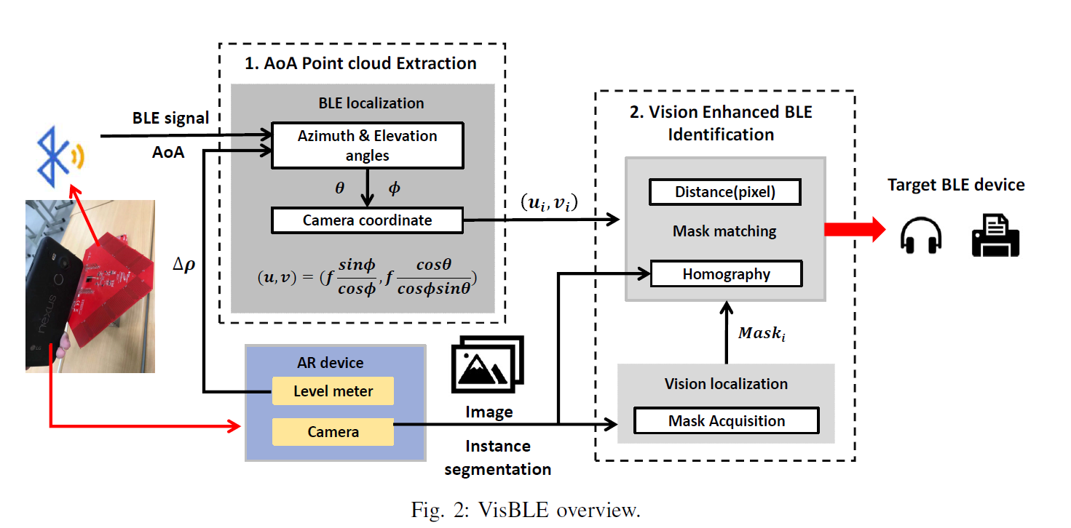

Slide 4
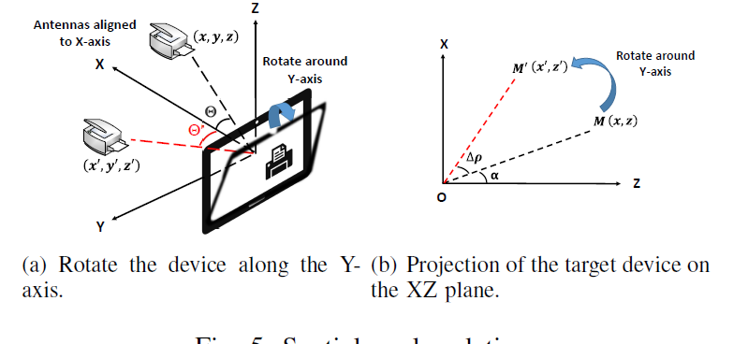
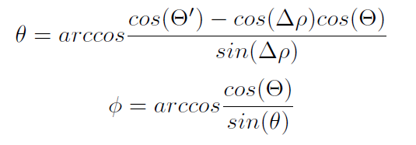
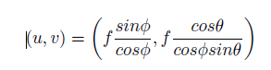
Pixel Proximity Matching

Slide 5
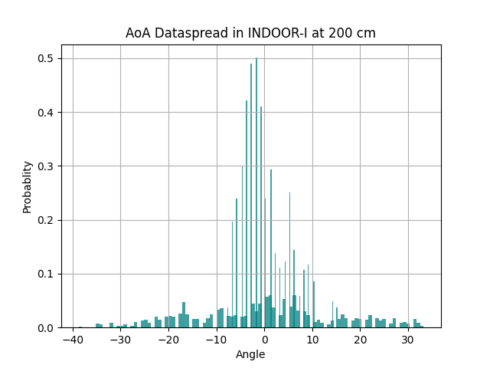
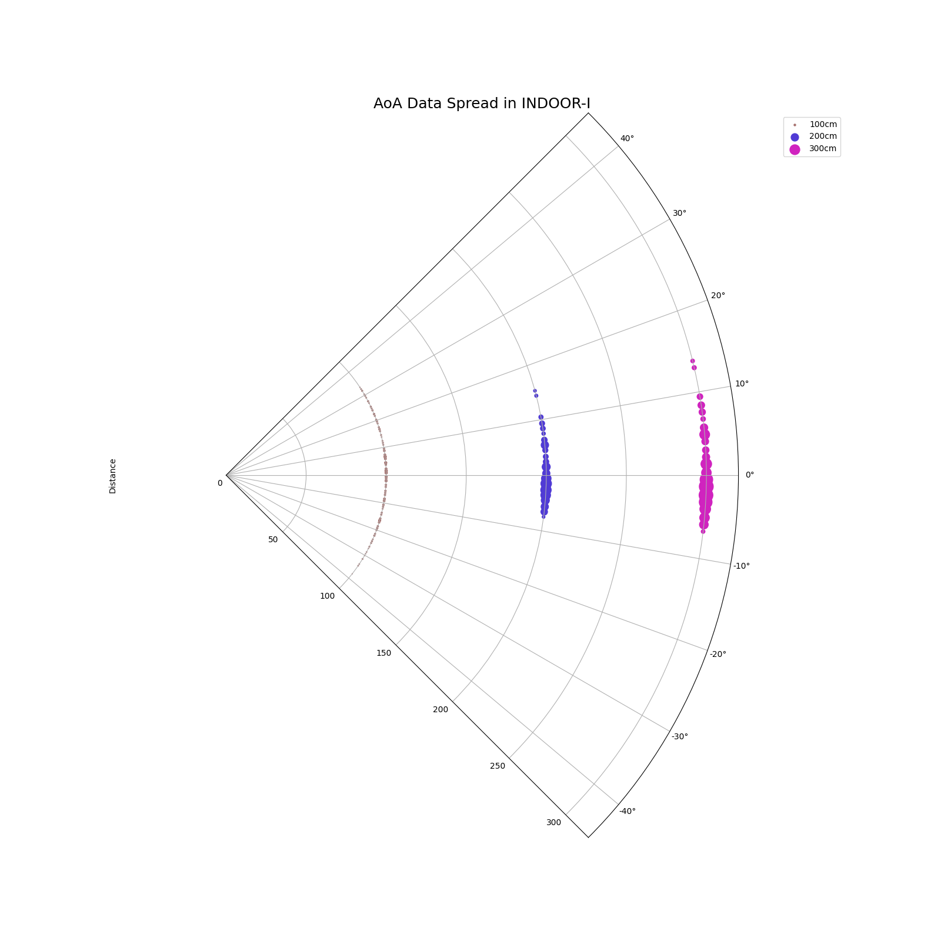
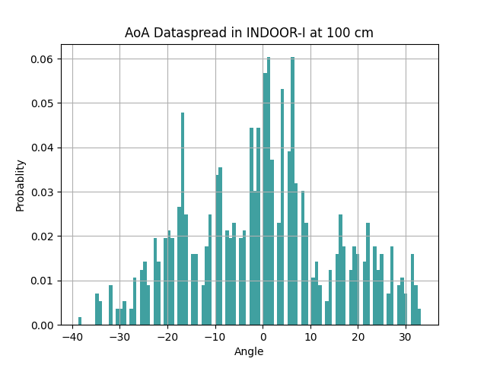
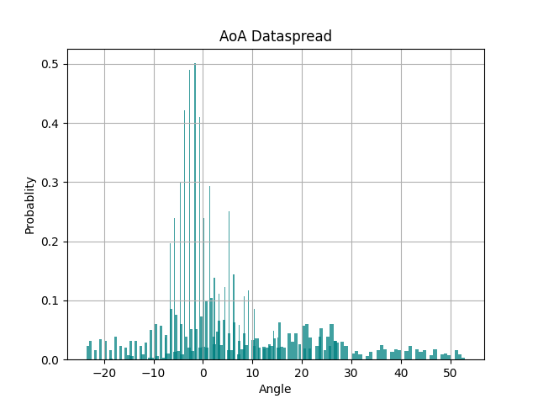
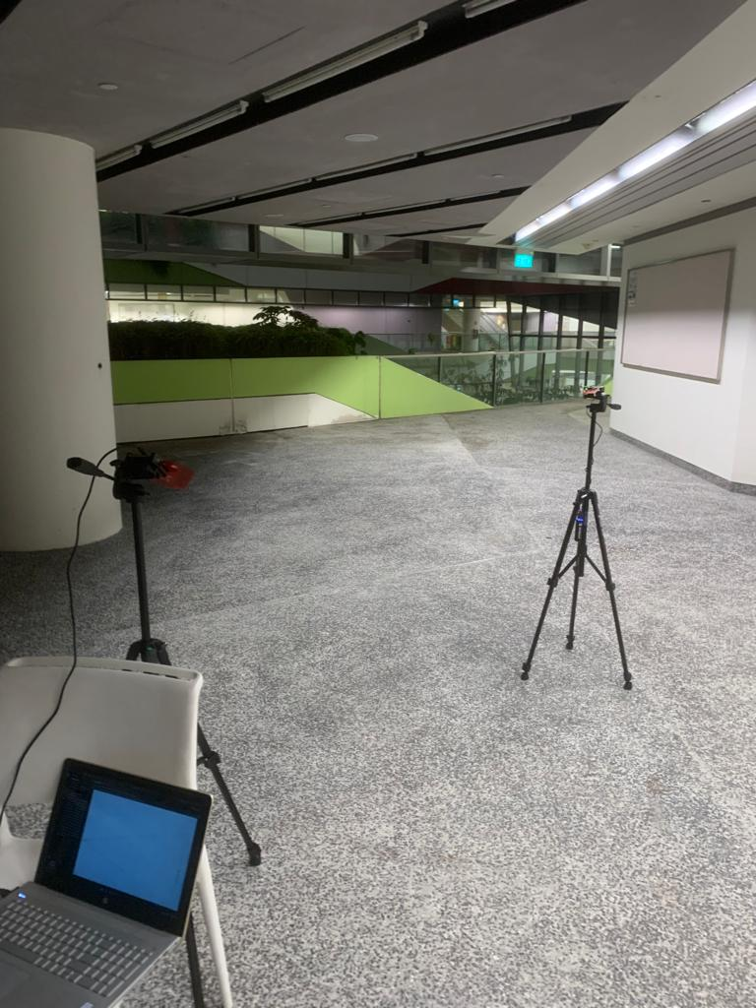
AoA Data Spread: Indoor Environment

Slide 6
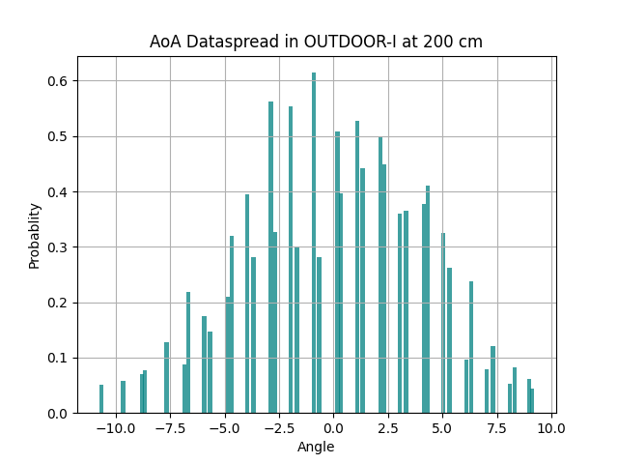
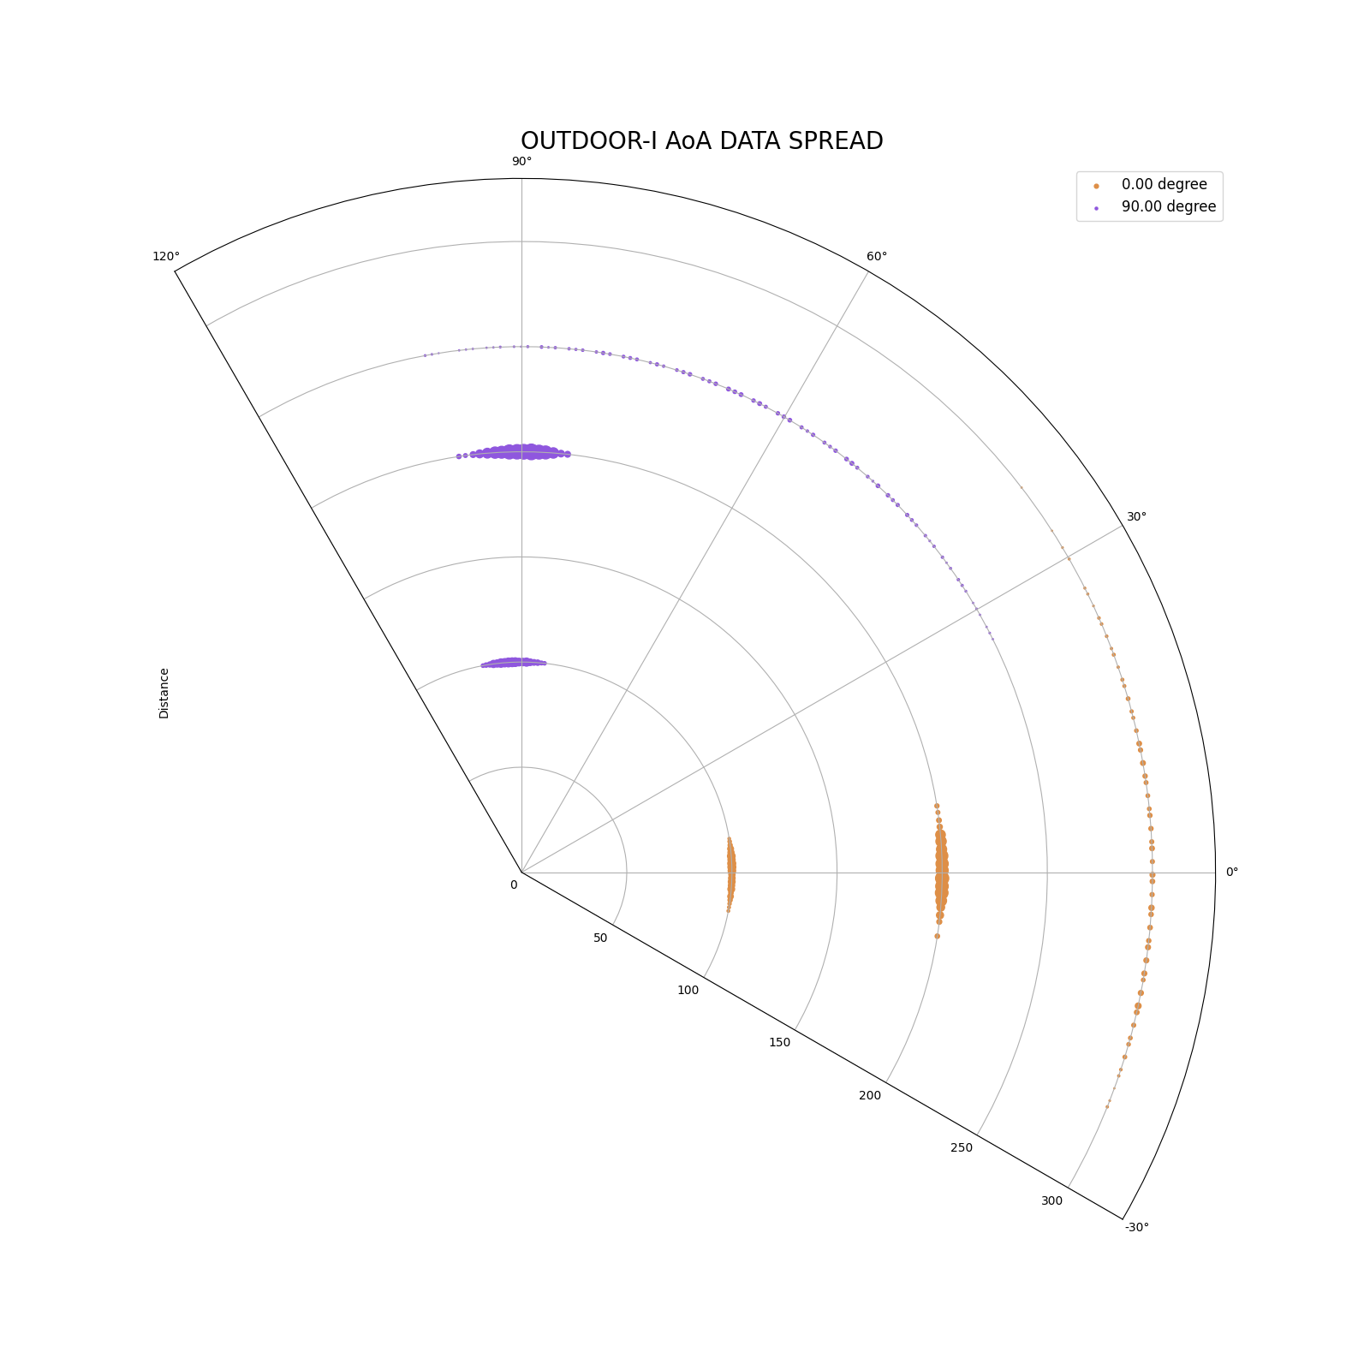
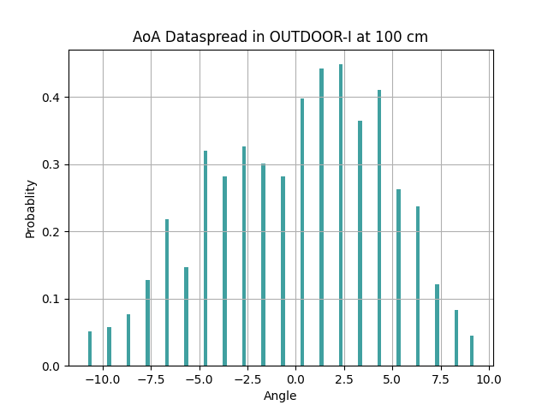
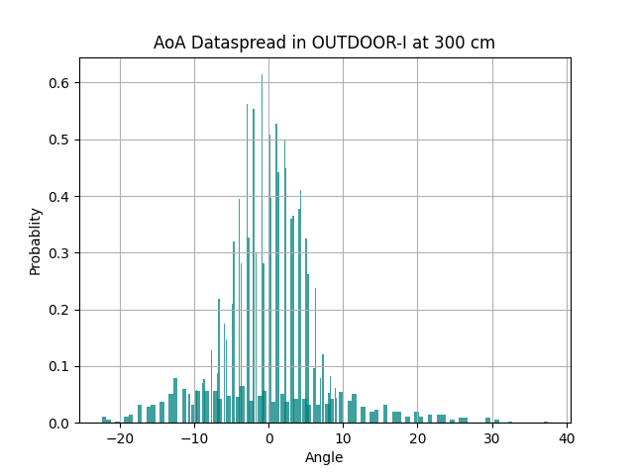
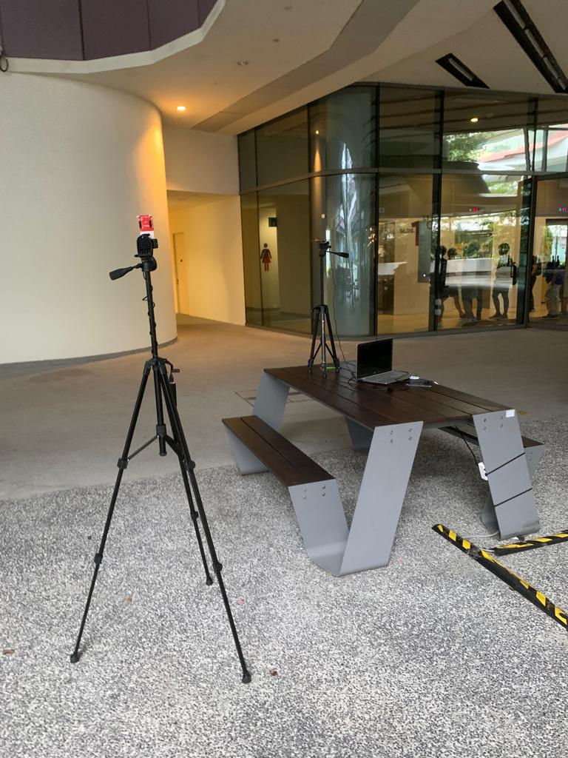
AoA Data Spread: Outdoor Environment

Slide 7
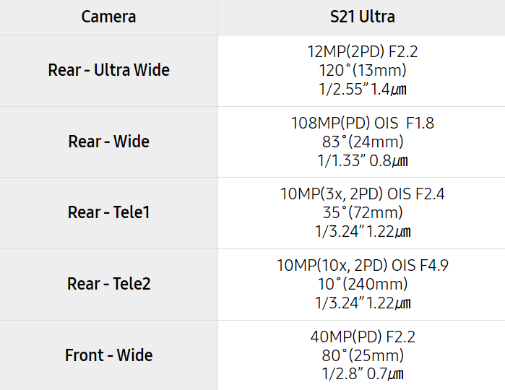
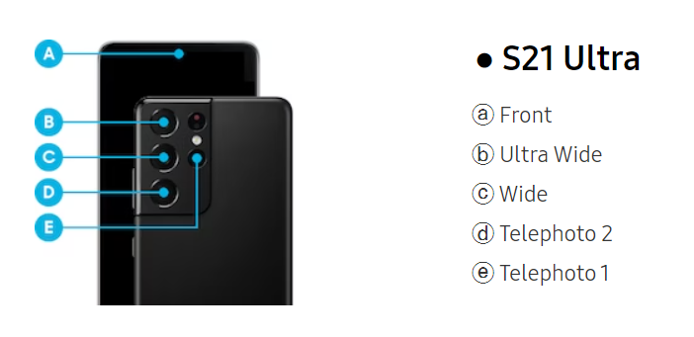
Understanding the Camera Structure,

Slide 8
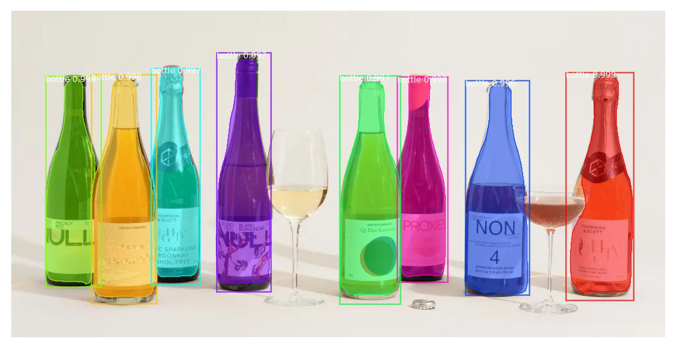
Mask RCNN for Bottle Segmentation
Purpose : Imitating the role of BLE transmitter with bottle with slave board on top. Masking bottle is seen as substitute of masking out BLE devices.
Results obtained with pre-trained weight
Transfer Learning???

Slide 9
Handling Multi Slave,
Issue – Was not able to differentiate between multiple slaves when we collect data in the same time.
Importance – Using K-Nearest Neighbors Algorithm to sort out best points, Pixel calculation
As long as we receive acknowledgement from a slave, we have a connection handle assigned to it.
Using the connection handle as the mean to differentiate
Storing the Mapping in dictionary and use it for device indication

Slide 10
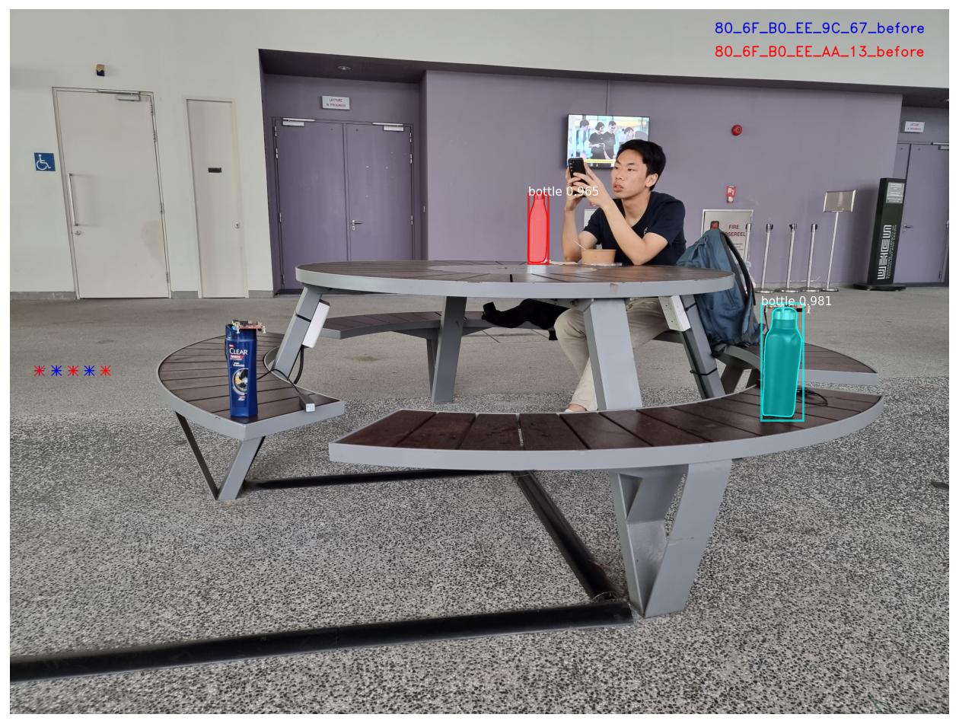
What you could expect,

Slide 11
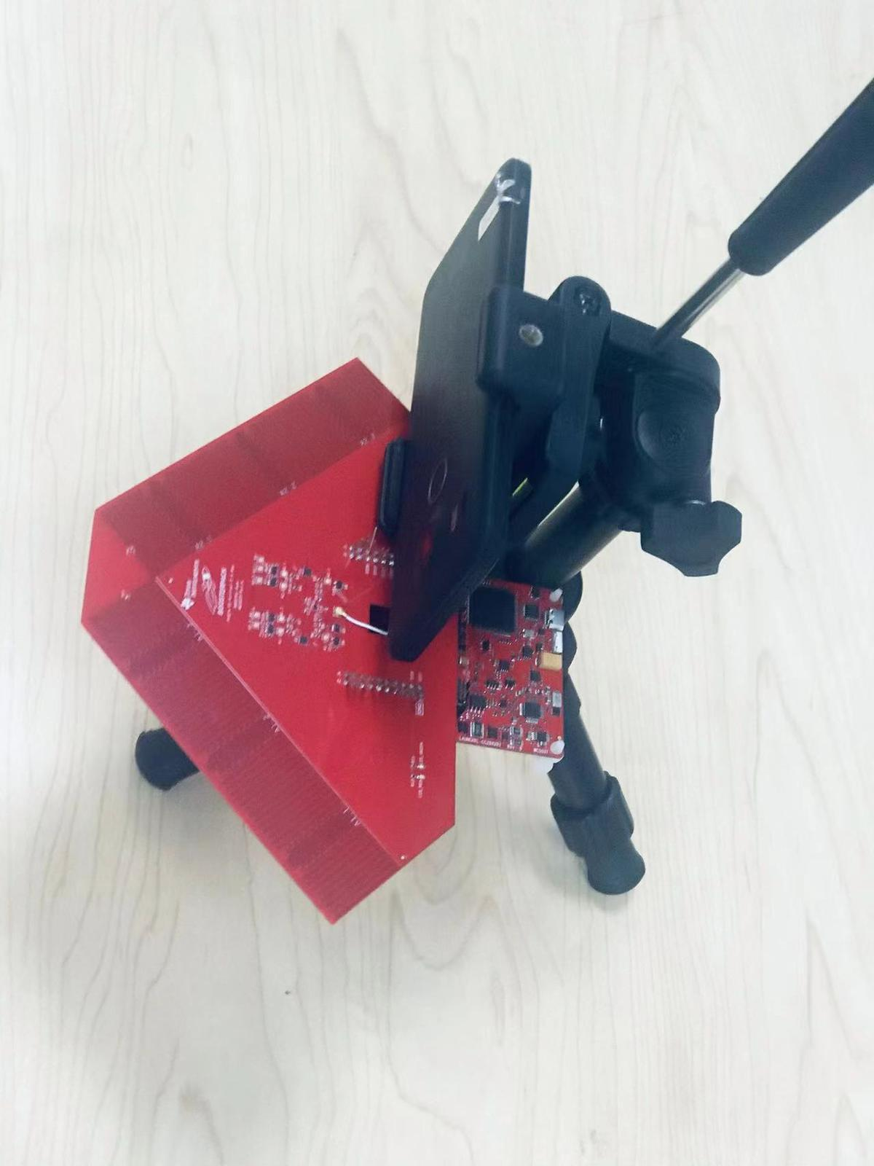
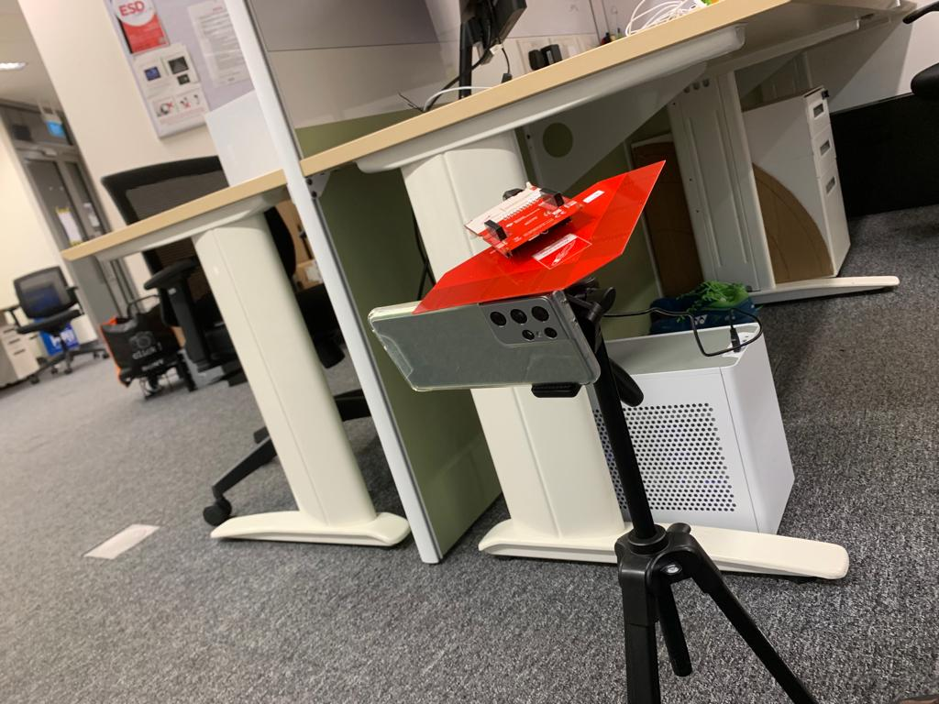
Antenna Configuration 1
Testing Procedure,
Mount the phone to the tripod as shown in the image on the right.
Attach the antenna board on top of the camera while aligning the center of the camera to the center antenna.
Collect the AoA data while maintaining the same structure.
While ensuring there is no rotation in other axes, rotated the phone about the y-axis and measure the level meter change and acquire the corresponding AoA data.
Based on the collected data perform the required calculations and arrive at the point cloud.
Antenna Configuration 2

Slide 12
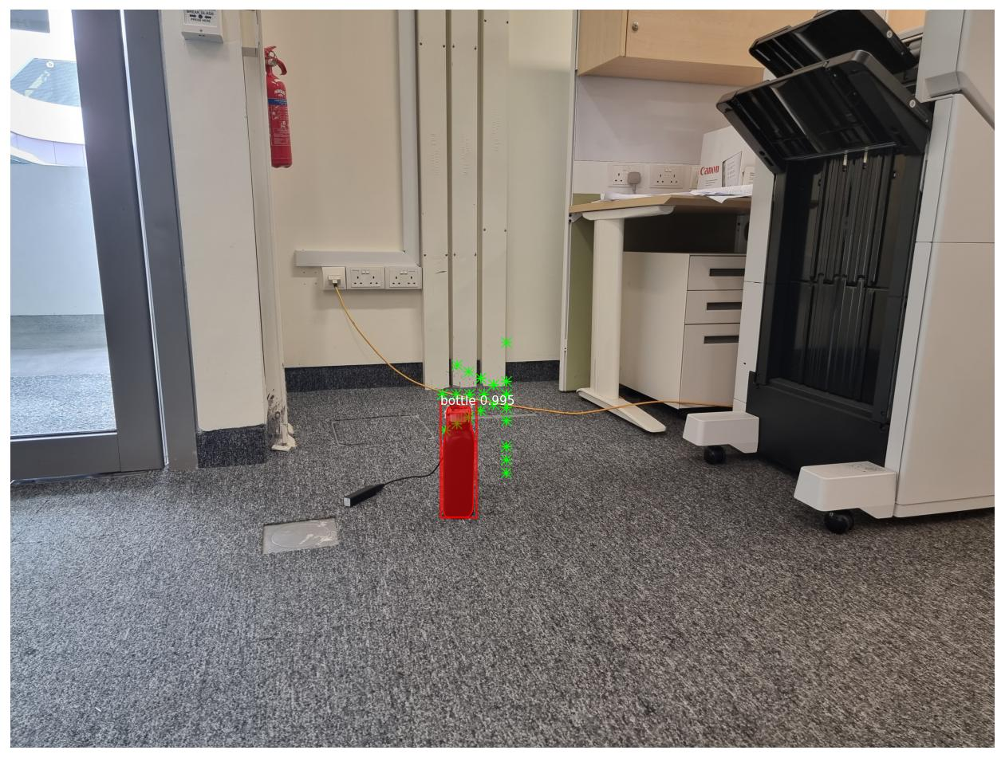
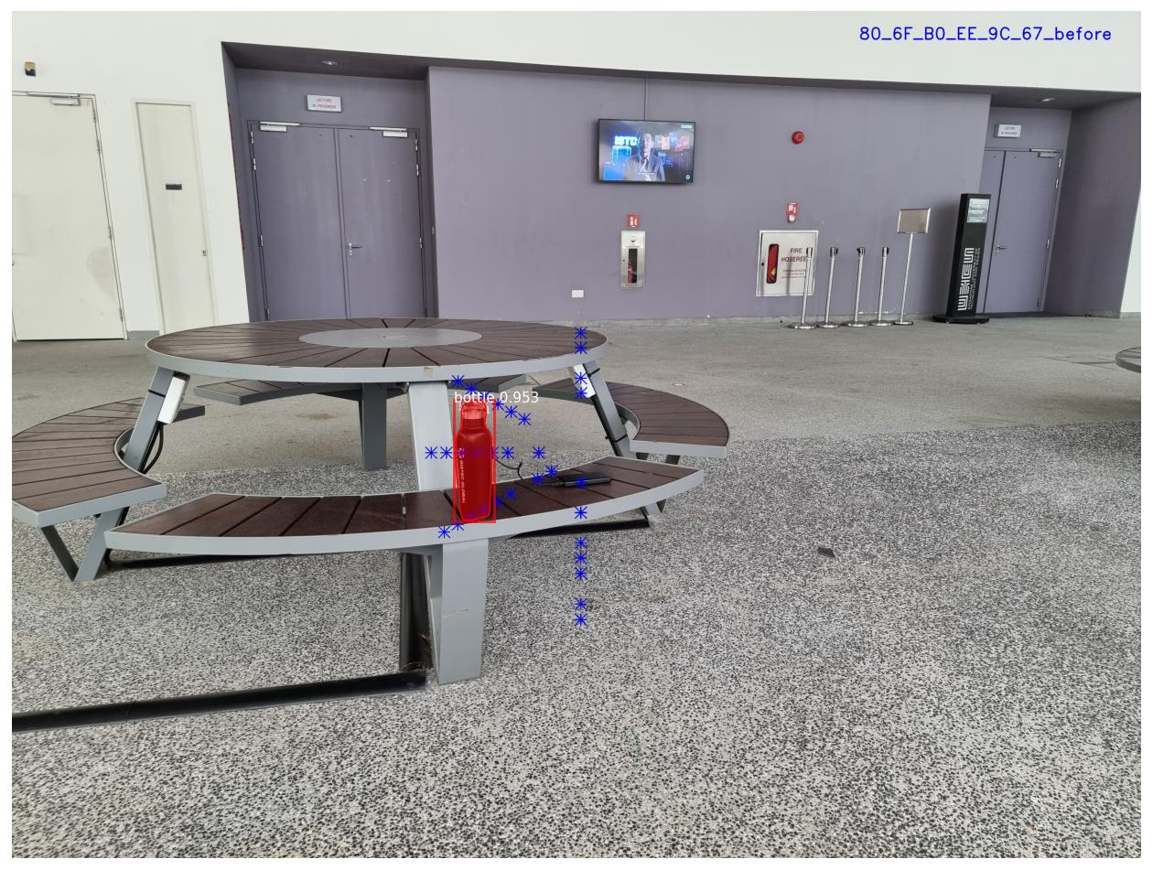
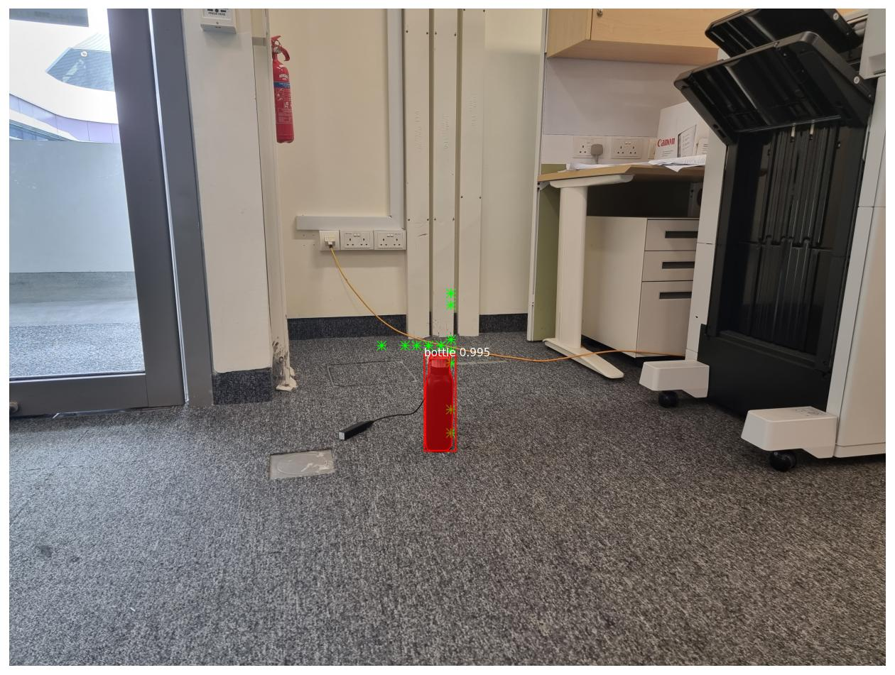
Pixel Proximity Matching Single Slave,

Slide 13
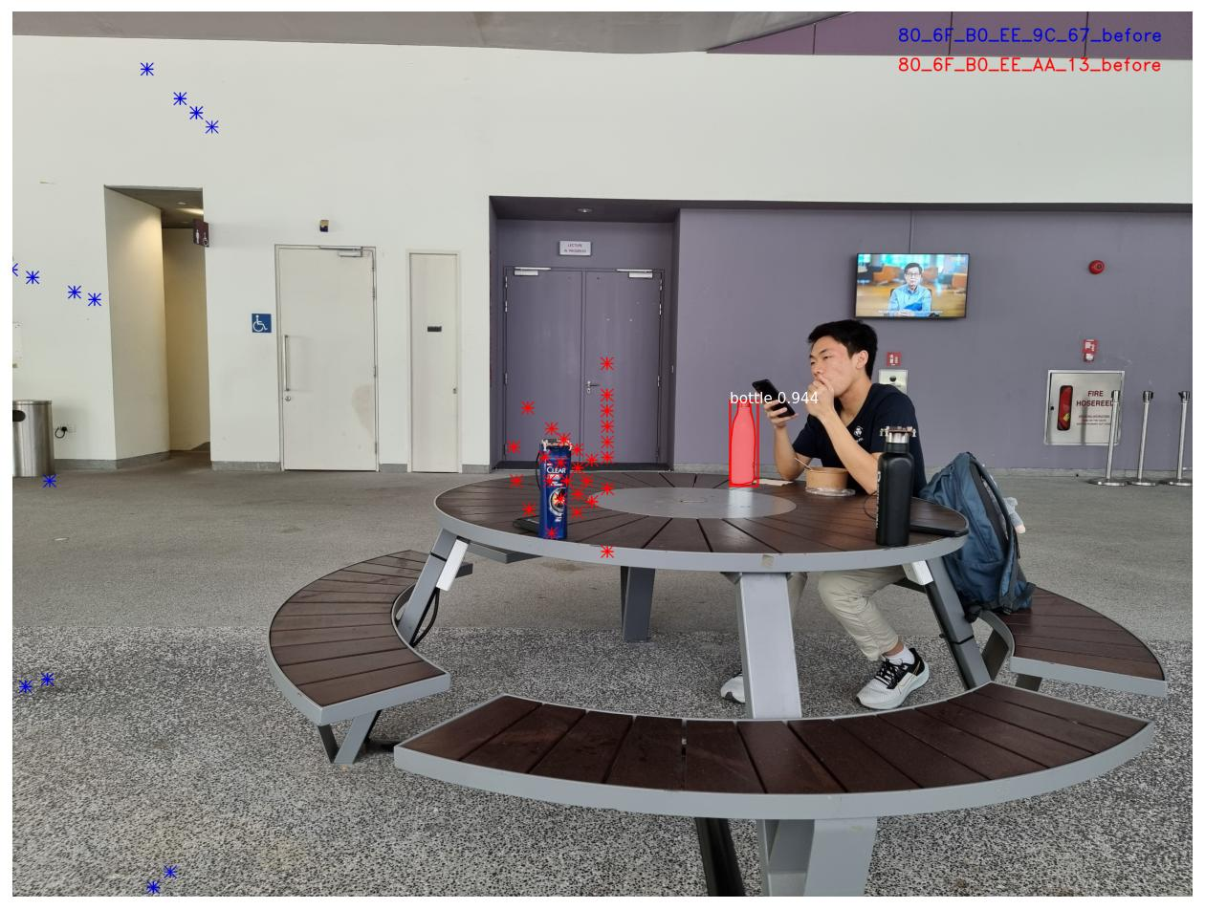
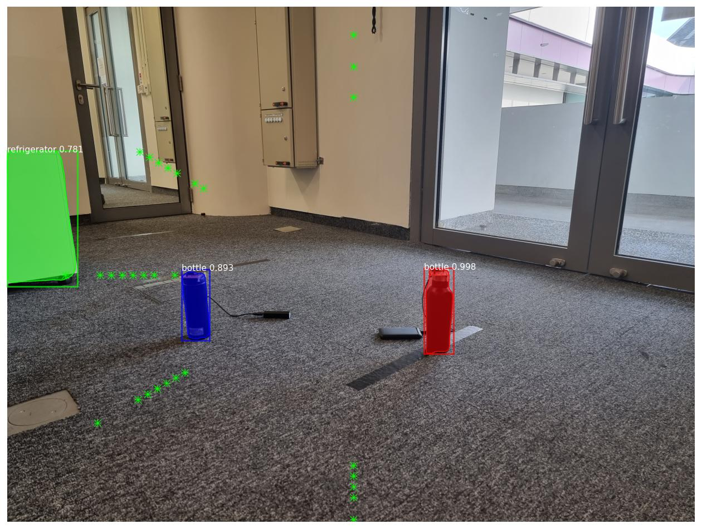
Pixel Proximity Matching Multi Slave,

Slide 14
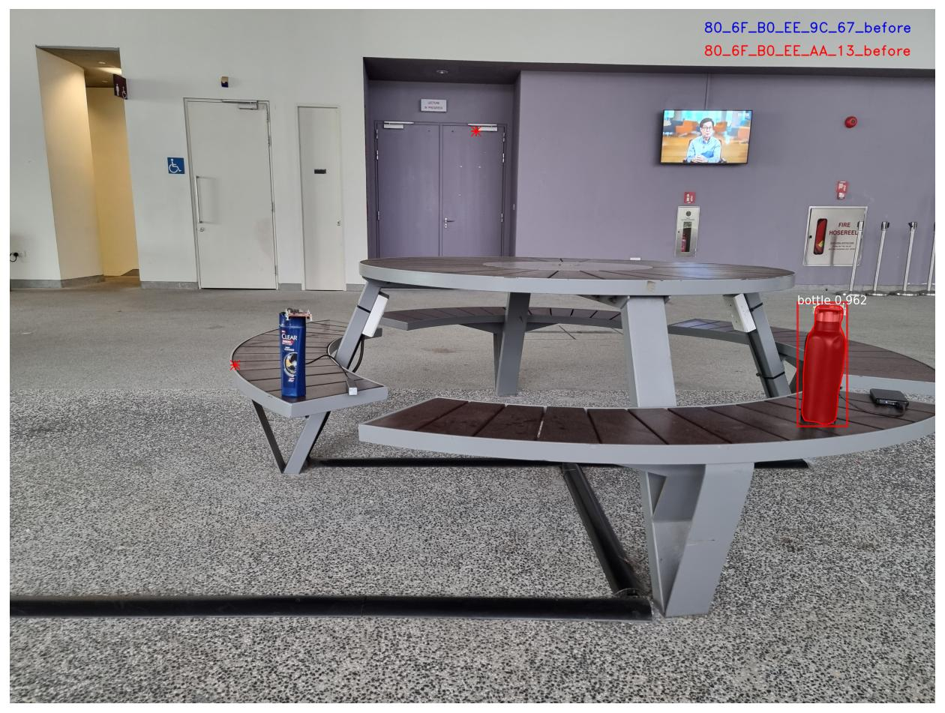
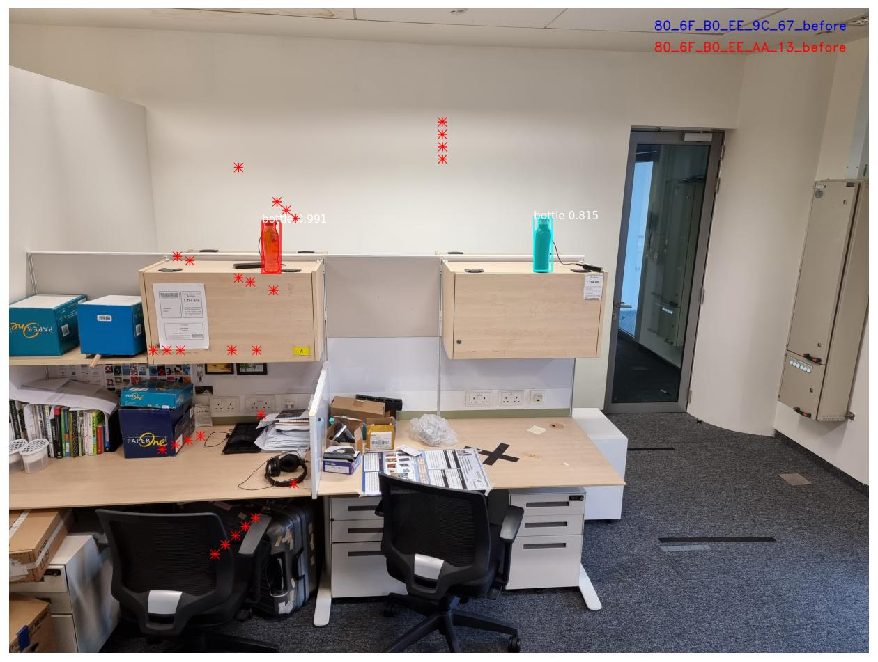

Slide 15
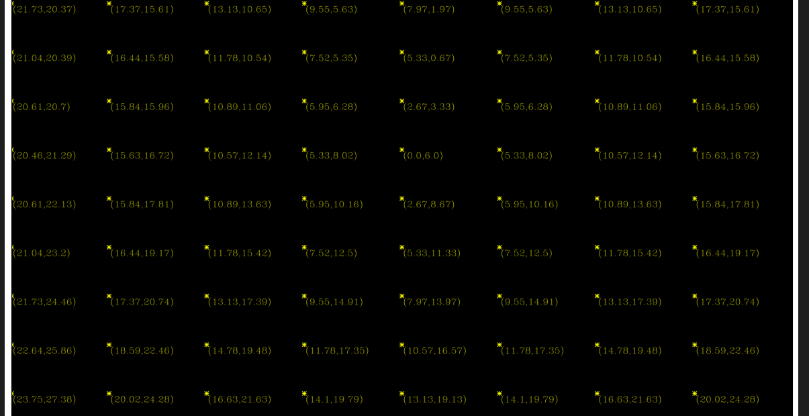
Reverse Inspection
By fixing the change in level meter angle, calculating the expected values for angle of arrival before and after turn.
Value 1: Expectation for angle of arrival value before the turn
Value 2: Expectation for angle of arrival after turning the camera

Slide 16
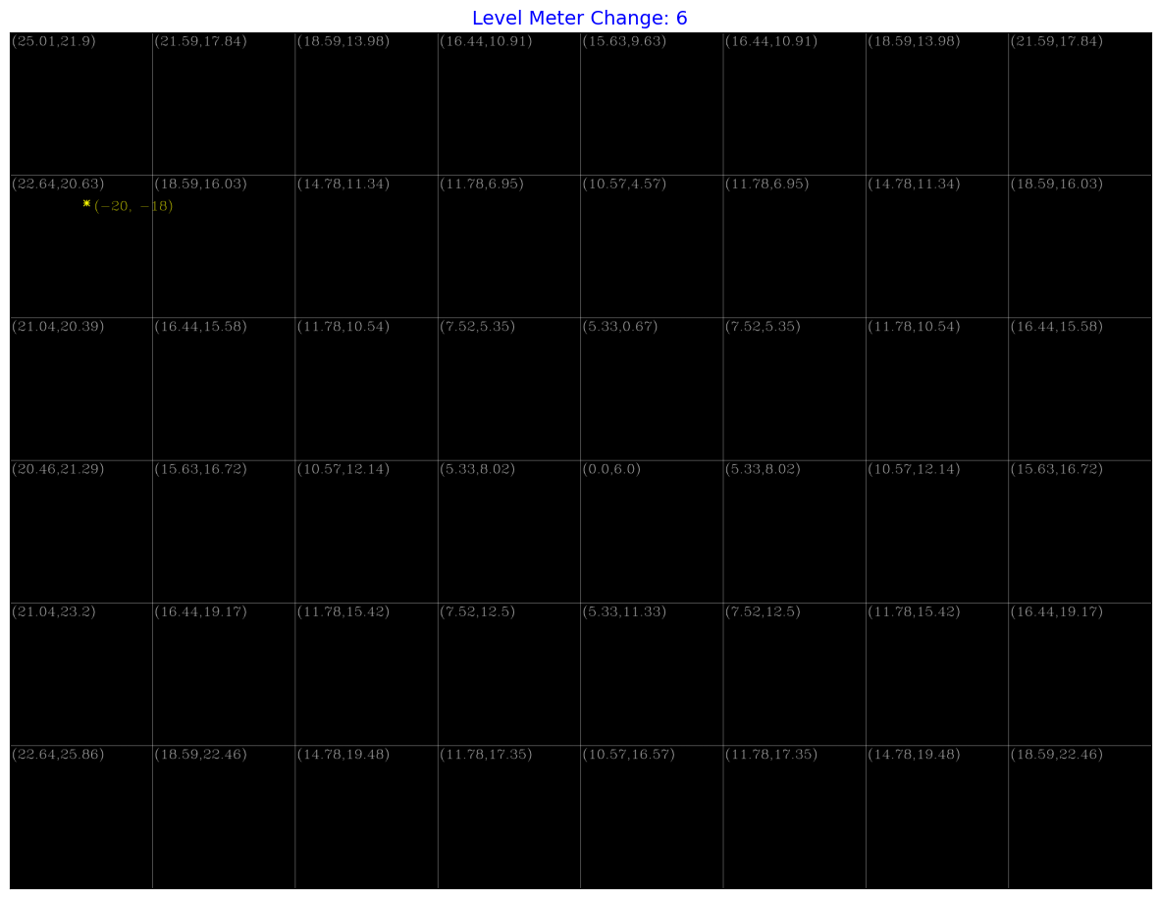
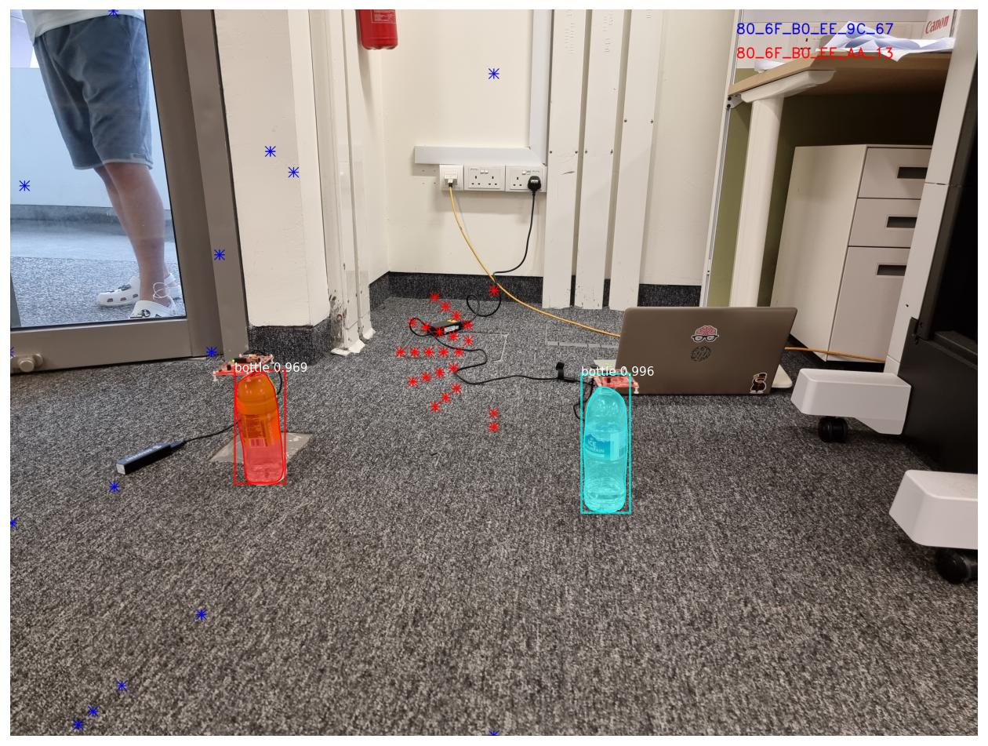
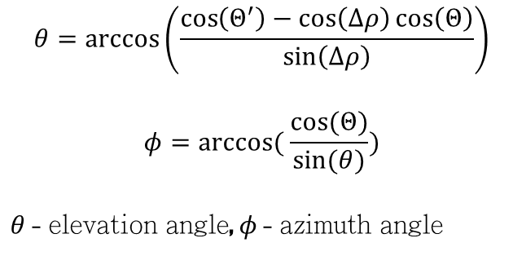
Azimuth Angle Ambiguity
$$θ=\arccos\left(\frac{\cos\left(Θ^{′}\right)−\cos\left(Δρ\right)\cos\left(Θ\right)}{\sin\left(Δρ\right)}\right)$$
$$φ=arccos⁡( \frac{cos⁡(Θ)}{sin⁡(θ)})$$
$θ$ - elevation angle, $φ$ - azimuth angle

Slide 17
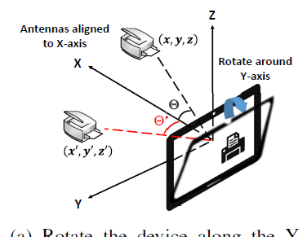
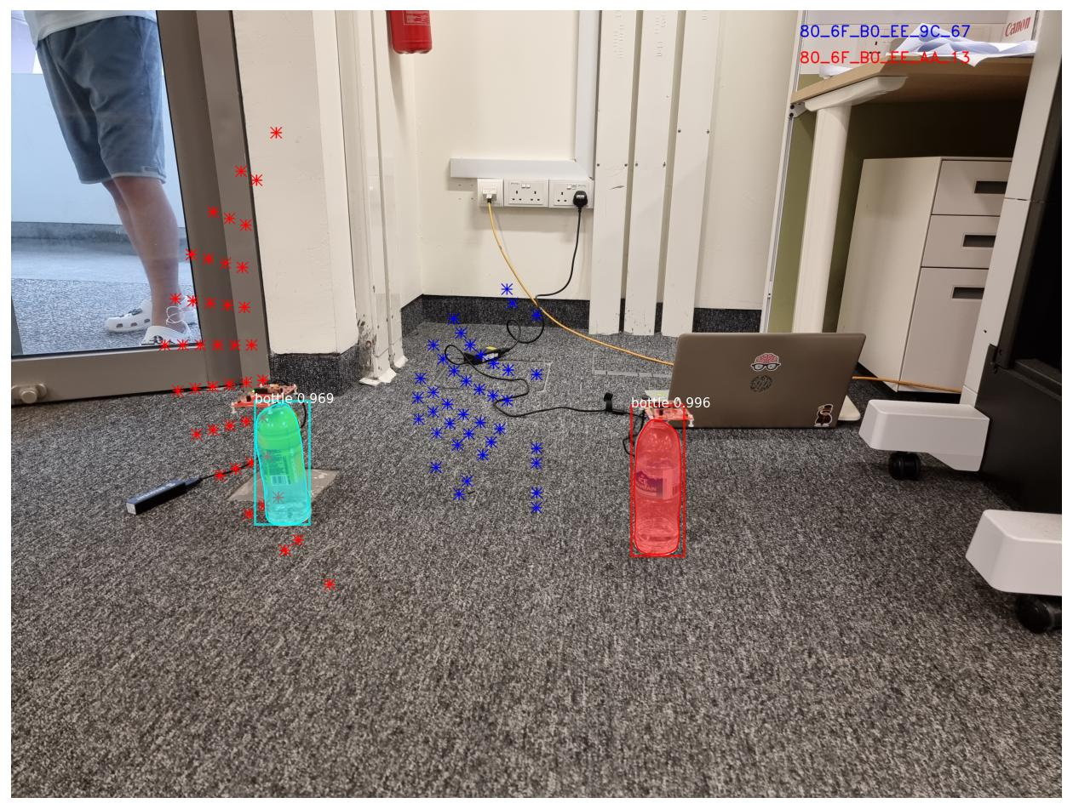
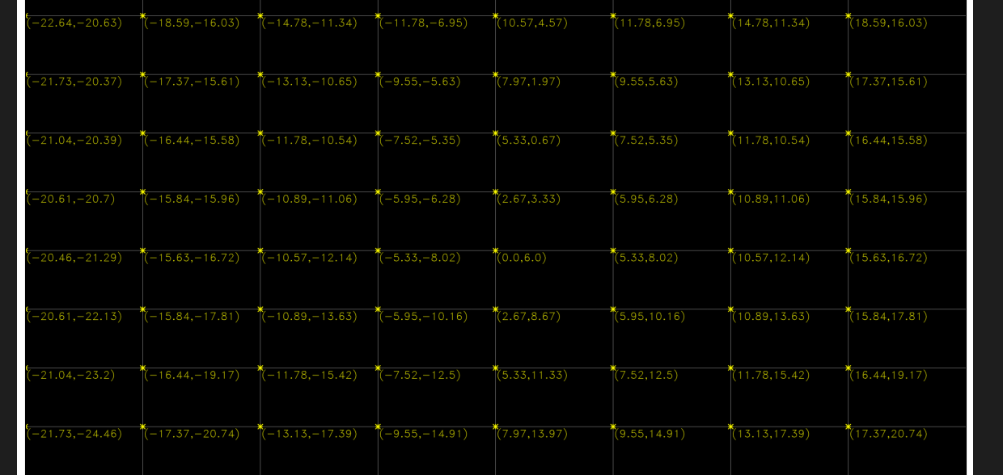
Solution:
Making azimuth as negative for positive values of angle of arrival.

Slide 18
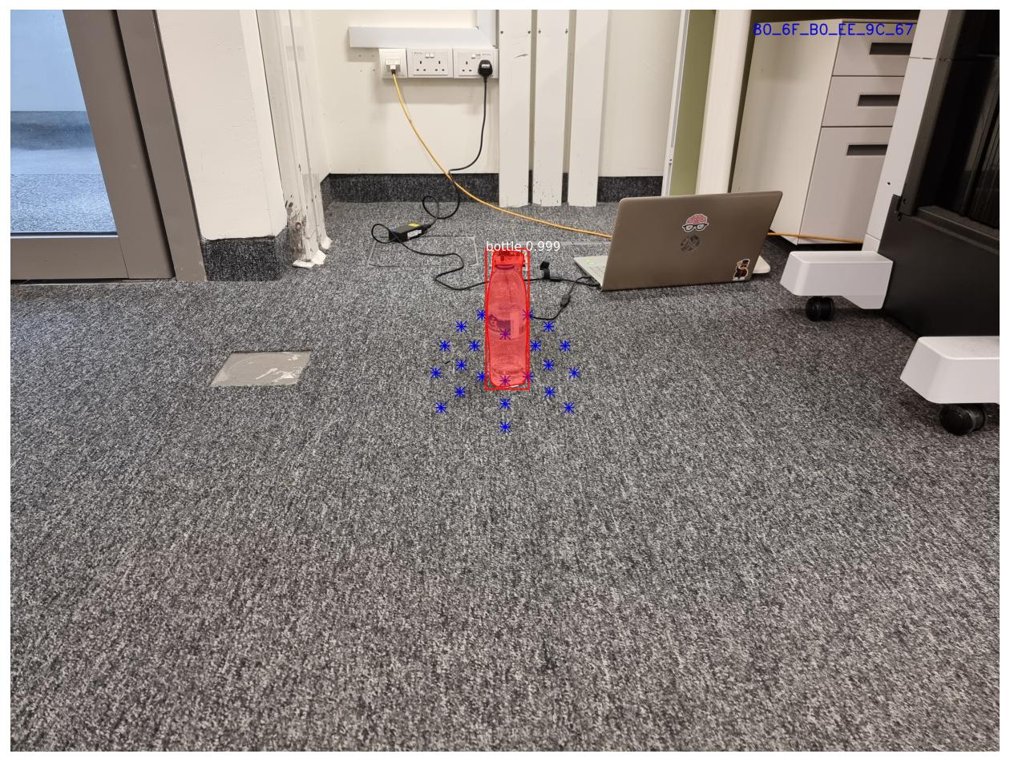
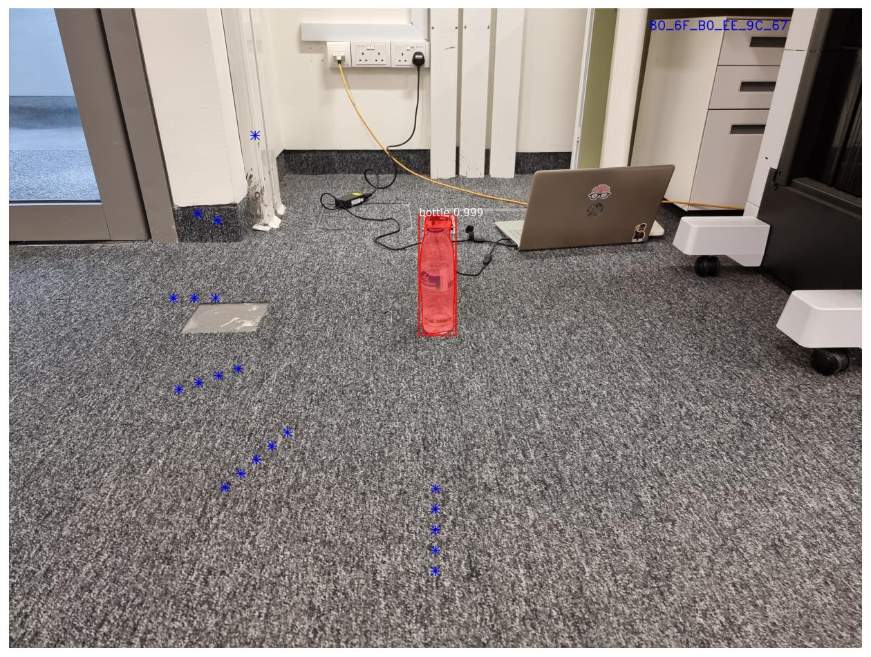
Pixel Proximity Matching Single Slave,

Slide 19


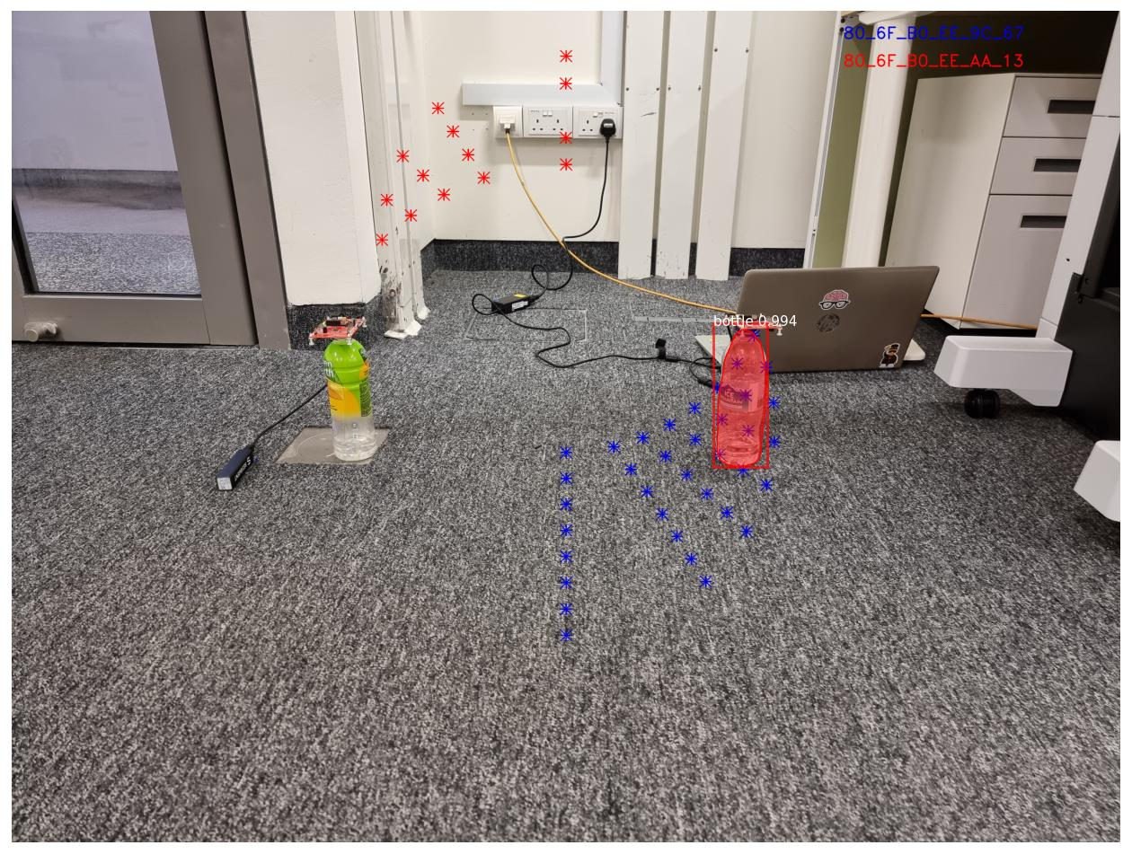

Pixel Proximity Matching Multiple Slave,

Slide 20
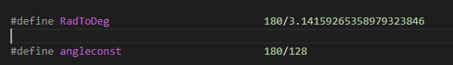
Angle Resolution Issue
Extract from aoa.c – Angle of Arrival Calculation Ti Board
Only 8 bits are used for angle calculation. So the result cannot be accurate more than 360/256 > 1
This imposes restrictions on possible point spread.
LET US ANALYZE THEM…!

Slide 21
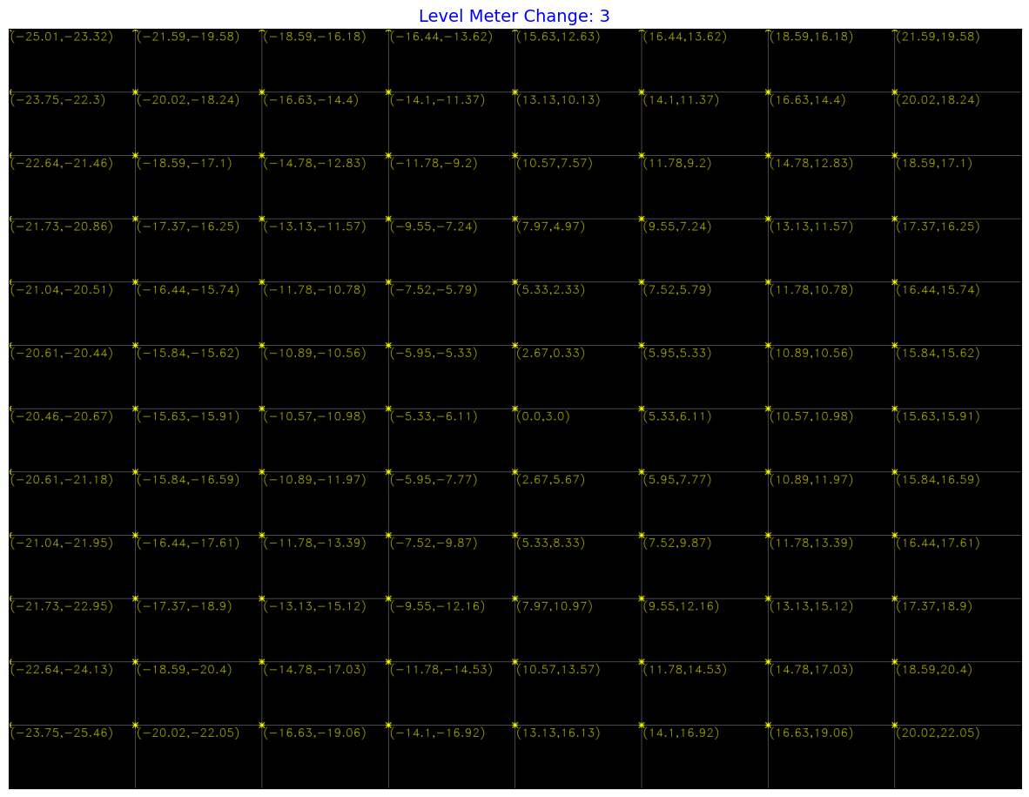
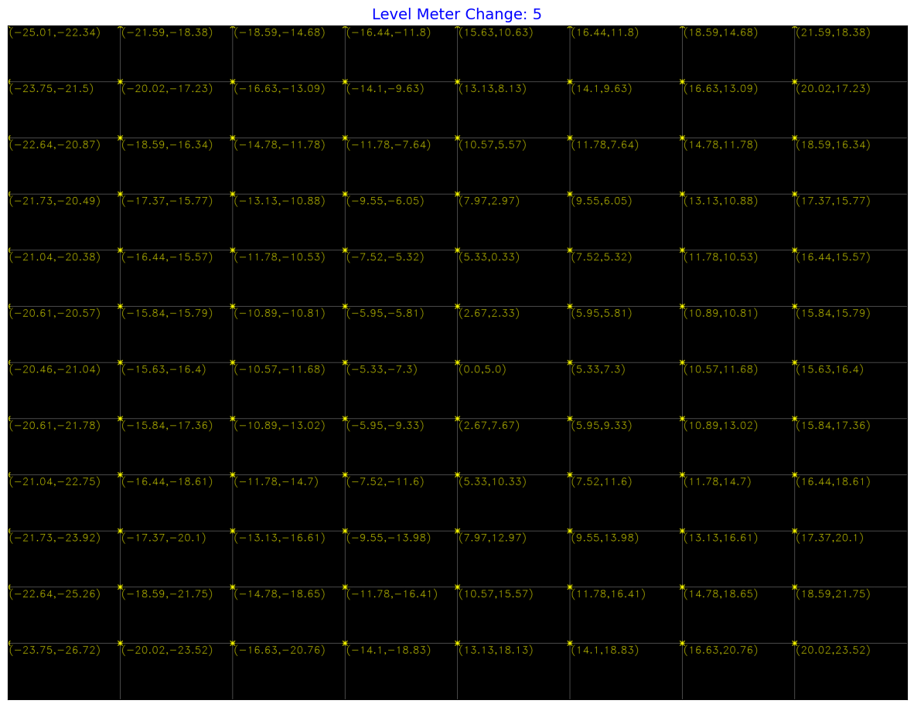
Expected Values for Angle of Arrival for Small Level Meter Change

Slide 22
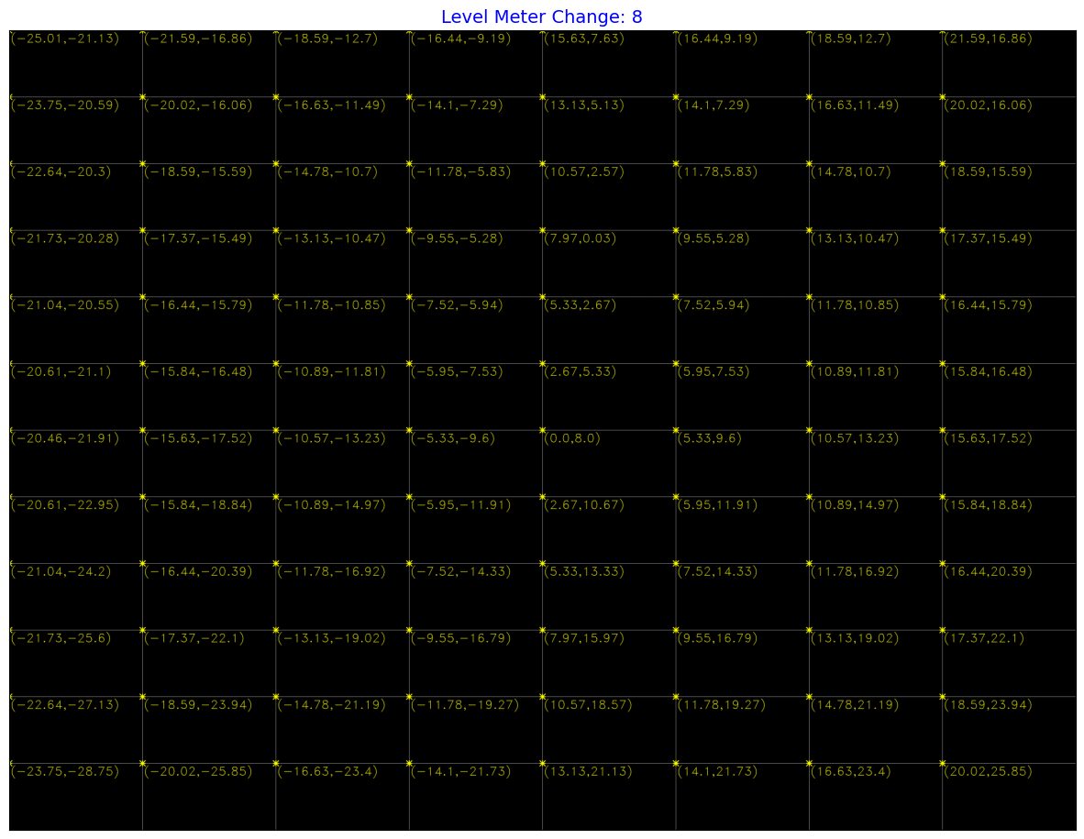
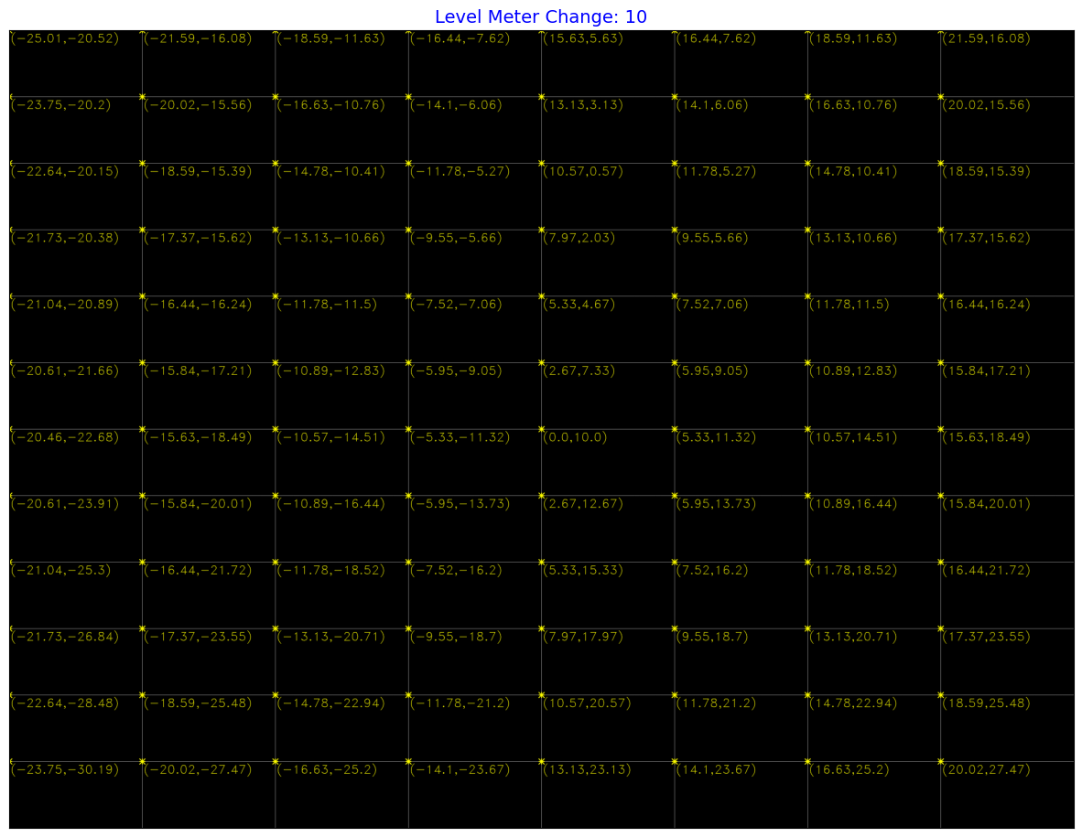
Expected Values for Angle of Arrival for Large Level Meter Change

Slide 23
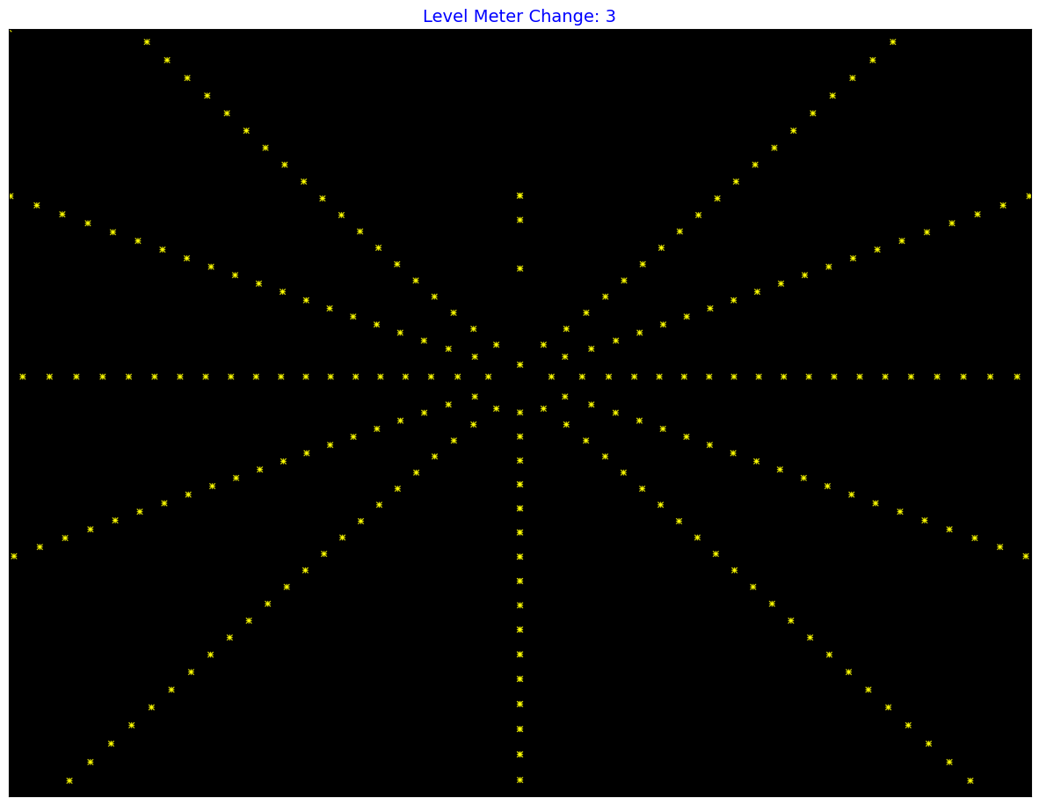
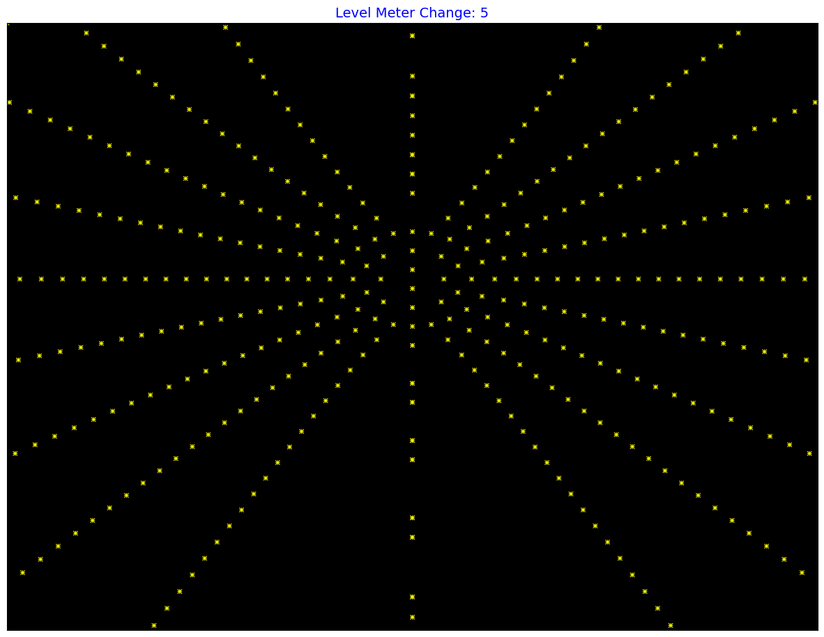
Point Location Possible on the Assumption of AoA Accuracy $±1$
Range: -30 -> 30

Slide 24
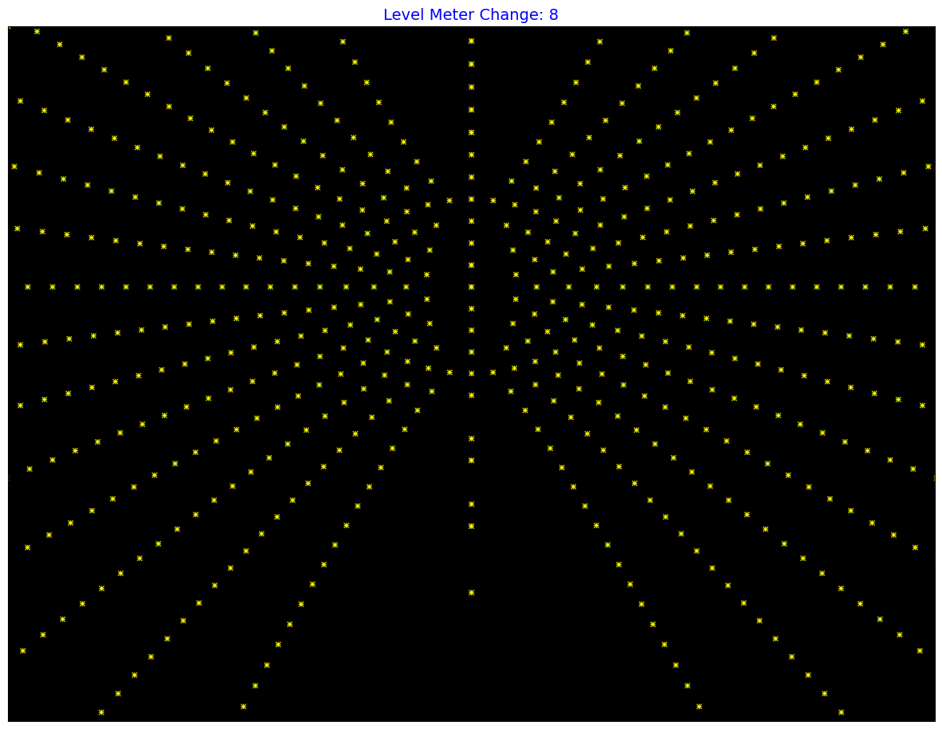
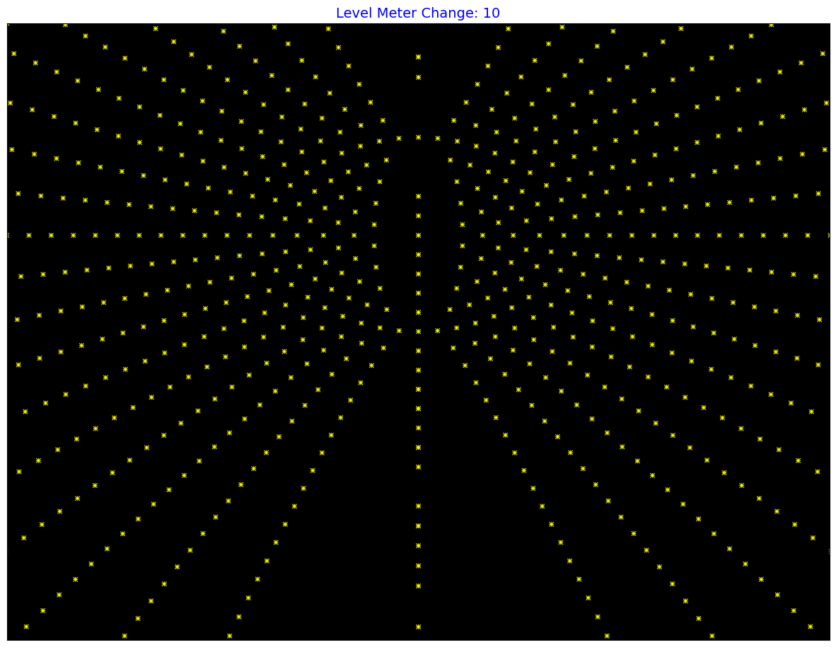
Point Location Possible on the Assumption of AoA Accuracy $±1$

Slide 25











Antenna Configuration
Choice - II
Choice - I

Slide 26





Data Filtration: AoA
Removed Anomalies
KNN
Local Outlier Ratio
Mean Absolute Difference
Isolation Forest
Interpolation
Cubic Spline Interpolation by choosing .5 accuracy
RAW DATA
Filtered Data
Scale Points Towards {Median/Mean/Mode}
Clamp the points by defining a threshold

Slide 27



Pixel Proximity Matching Multi Slave,
OUT DOOR DATA SET
INDOOR DATASET

Slide 28



Increase Level Meter
Change
Camera Parameter
Adjustment

Slide 29




From Previous Student

Slide 30




CALIBRATION
(c_x, c_y) => Calibration Matrix
Look for more Ideal Data and Calibration on More Data...!

Slide 31



Constraint on Level Meter Change
FOV : ${83}^{o}$

Slide 32

Compressed Sensing
Representation based on Some Basis :
Measurement :
Problem :
$$f= φx (Choose basis to make x a sparse vector)$$
$$b= ∅f$$
$$sparsest solution satisfying Ax=b (Can be achieved by reducing {\left\|x\right\|}_{1})$$
Related Idea
Since we expect the data to be denser only in the locations of devices the points vector can be considered sparse in pixel domain.
Based on the accuracy limitation it is visible that we can only identify the points according to a very low resolution grid.
Possible Problem Formation
If we can measure a low resolution grid data for possible locations. Can we use this to recreate a more accurate pixel location?

Slide 33
Algorithm Proposal
Divide the image into a low resolution grid.
Apply the voting scheme: For each pair of possible angle of arrival we calculate the relevant pixel and vote for the relevant section in the low resolution image.
Based on the votes we allocate the area for corresponding slave by giving priority to the slave with maximum vote.
Two possibilities
Allocating only one section to a slave.
Allocating all possible sections
Help to handle the overlapping problem of pixels.
Later we can use the compressed sensing for the recreation of more accurate location.

Slide 34


Homography Based Matching
Take a photo in the initial position of phone camera. Rotate the phone camera by a small angle and take another photo.
Mask-out the bottles using mask RCNN model in both the images.
Match the masks and find the corresponding homography transformations.
Match the area coming under the point clouds and find the corresponding homography transformations.
Based on the homography matrices match the point clouds with bottles.

Slide 35



DEMO: Finding Homography
Good feature points together with their descriptors(SIFT Feature Descriptor) are extracted from the two images.
Using the K-Nearest Neighbor algorithm two nearest neighbors for feature points in one image are separated from feature points of the other image.
Based on the ratio test on the two matches I sorted the good matches.
Using the good matches homography matrix is calculated.
Image Stitching

Slide 36



Results: Rotation

Slide 37




Results: Translation

Slide 38





Performance - Previous
Impact of Level Meter
Azimuth and Elevation
Impact of Tripod
Median Error → Azimuth - ${2.2}^{o}$ ; Elevation - ${3.1}^{o}$
Position Accuracy → Median – 246; 95-percentile – 481 (4032 * 3024)
Master is 1m apart from slave, Median 246 equivalent to 8.3cm
Impact of Distance
246 → 280

Slide 39

Computational Efficiency
Vectorization.
Reduction of unnecessary calculation while preserving the whole information.
Consideration of computational expense on Homography calculation
RANSAC : Random Sample Consensus
LMEDS: Least Median Squares

Slide 40




3D Model For Antenna Board,

Slide 41
Experiments….!

Slide 42



Localization of Multi slaves
Tripod
UI
Free Rotation??

Slide 43





Effect of Acquisition Time on Accuracy
Ideal Environment
Reflective Environment

Slide 44





Effect of Distance on Accuracy
One Slave
Two Slave
Three Slave

Slide 45


